Slide 1
Module 8: Building with controls, fields, and formulas

Slide 2
Data types
Understanding controls
Understanding formulas
Power Apps and Excel formula comparisons

Slide 3
Data types
Number – 123.456
Text – Hello World
Boolean – True or False
DateTime – 1/12/2017 12:00 PM
Date – 1/12/2017
All can hold blank (null) values
Test with IsBlank function
Create with Blank function
Notes:
Also known as Primitive Data Types

Slide 4
Variables – Usage
In general, avoid using variables. But sometimes only a variable can enable the experience you want.
Think Excel when you think about data manipulation and Excel type formulas.
Notes:
https://docs.microsoft.com/en-us/powerapps/maker/canvas-apps/working-with-variables
Discuss:
A great example of why you might want to use variables is when you want to work within a screen, while performing a function that takes time you can use a function within a button to change the text

Slide 5
Variables – Types
Global Variables
App Scope
Usage: Set(MyVar,1)
Context Variables
Screen scope
Usage: UpdateContext({MyVar:1})
Collections
App Scope
Collect(Cars,{Make:Porsche,Year:2019})
Simplest to use
Great for passing values to a screen, much like parameters to a procedure in other languages
Holds a table of data and can be saved to the local device for later use
Notes:
Discuss:
The types of the variable is derived implicitly from the values that are placed in them.
All variables are held in memory while the app is running. After the app closes, the values held in the variables are lost.
You can store the contents of a variable in a Data Source using Patch or Collect functions, or in the case of collections you can store to the local device with the SaveData function.
When the app is first loaded, all variables will have the blank value.
How global variables work:
You set the value of the global variable with the Set function.
You use the global variable by referencing the name used with the Set function. In this case, MyVar will return 1.
Global variables can hold any value, like string, Boolean, numbers, records, and tables.
How context variables work:
You create and set context variables by using the UpdateContext function.
If a context variable doesn't already exist when first updated, it will be created with a default value of blank.
You create and update context variables with records, use { MyVar: 1 }
You can set a context variable when a screen is displayed, by using the Navigate function. This is similar to parameter passing in other programming tools.
Except for Navigate, context variables are limited to the context of a single screen.
Context variables can hold any value, including strings, numbers, records, and tables.
How collections work:
Create and set collections by using the ClearCollect function.
You can use the Collect function instead, but it will effectively require another variable instead of replacing the old one.
A collection is a kind of data source and, therefore, a table.
To access a single value in a collection, use the First function, and extract one field from the resulting record. If you used a single value with ClearCollect, this will be the Value field, as in this example: First( VariableName ).Value
Can be saved to the local device with SaveData, LoadData
Great for taking apps offline
All viewable from the File menu “Variables” and “Collections” tabs
Ref: https://docs.microsoft.com/en-us/powerapps/maker/canvas-apps/functions/function-updatecontext
https://docs.microsoft.com/en-us/powerapps/maker/canvas-apps/functions/function-set
https://docs.microsoft.com/en-us/powerapps/maker/canvas-apps/functions/function-clear-collect-clearcollect

Slide 6
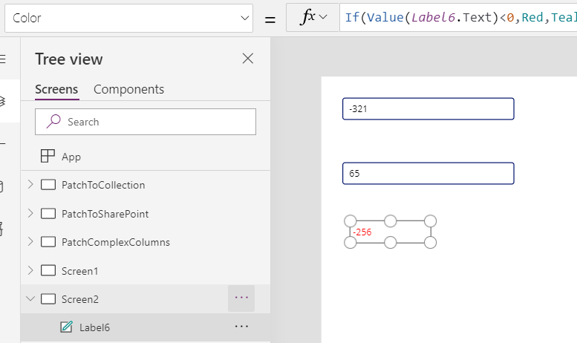
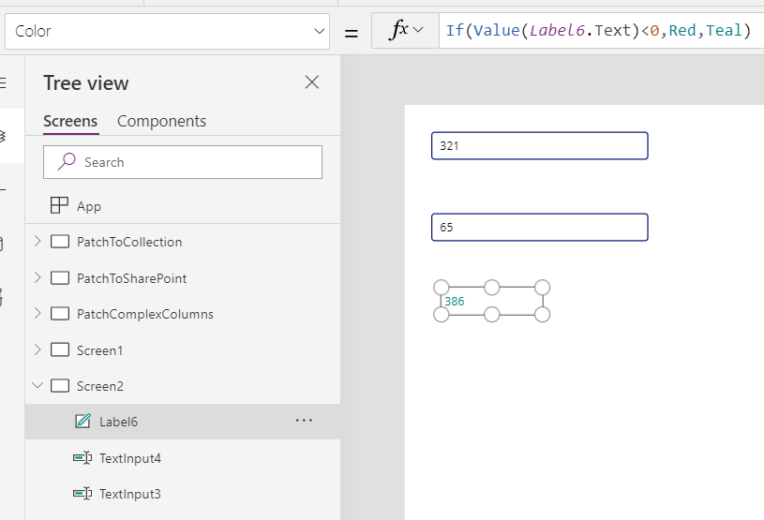
Variables – Using formulas
Replicate Excel behavior in an app by:
Adding a label control and two text input controls.
Setting the text property of TextBox1 to TextInput1 + TextInput2.
This will show the sum of whatever numbers are in the text boxes, automatically.
Notes:
Discuss using formulas :
If you know Excel, you know Power Apps. The model and formula language are the same.
Simplifies coding, reducing work needed to create same feature. Let the formula engine in Power Apps work for you.
Greater control of results (Can’t be updated by other code)
Provides ability to perform ‘What if’ queries by simply returning the formula to it’s start state (Think of a slider can change it up and down and then return to zero)
If you want you can use other sources in your formula like GPS from mobile device or a SharePoint list
https://docs.microsoft.com/en-us/powerapps/maker/canvas-apps/working-with-variables

Slide 7
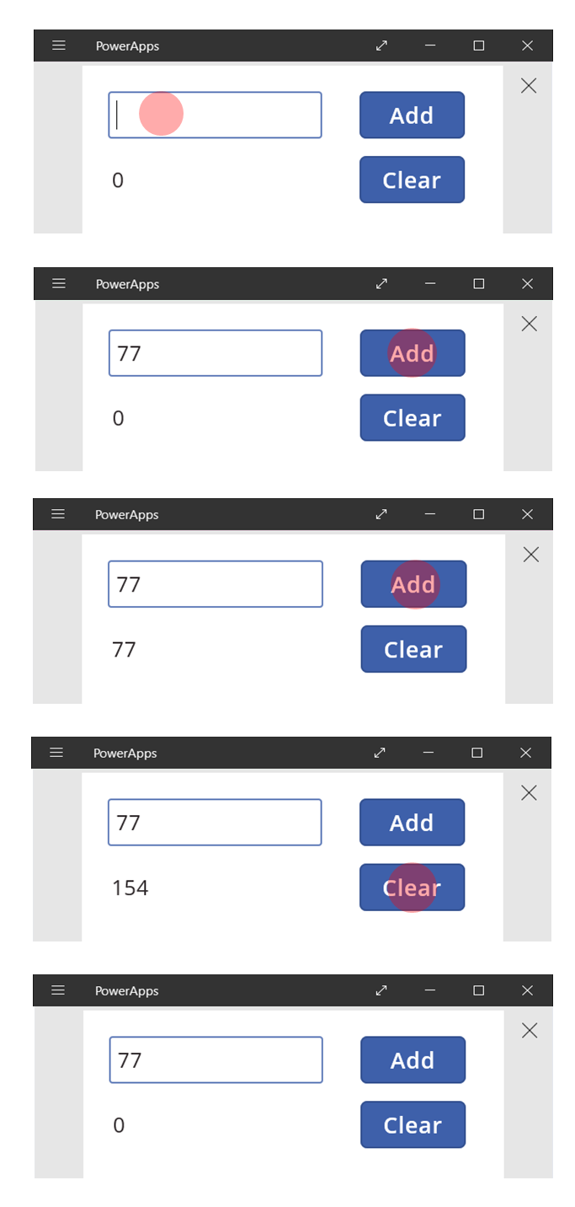
Variables – When to use them
Step1: Insert value in text box.
Step 2: Click Add. Total becomes 77.
Step 3: Click Add. Total becomes 154.
Step 4: Click Clear. Total becomes 0.
Notes:
Discuss:
Variables come with caveats:
Need user action to update the running total. Automatic recalculation won't do it for you.
Changes to the total can come from different user actions. Troubleshooting can be problematic.

Slide 8
State variables
Global variables
App-wide scope
Primary function: Set
Context variables
Local-screen scope (the screen’s “context”)
Pass values to a screen like passing parameters to a procedure
Primary functions: Navigate, UpdateContext
Collections
App-wide scope
Tables only
Primary functions: Collect, Clear, ClearCollect, Update, Remove
Can be saved to the local device with SaveData, LoadData
Great for taking apps offline
All viewable from the file menu Variables and Collections tabs

Slide 9
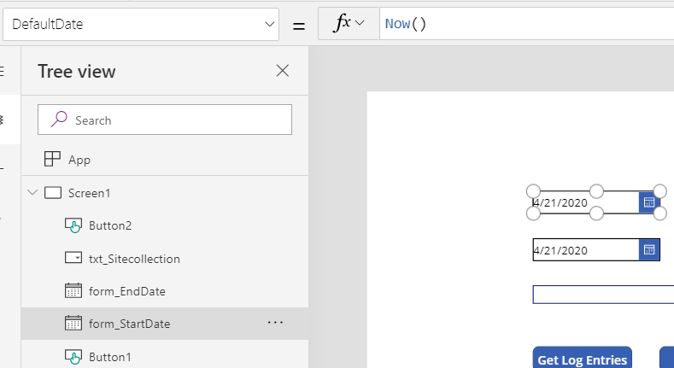
Controls and formulas
Controls show or get information
Formulas manipulate data
Formula bar
Formula
Property
Controls
Notes:
Discuss:
Controls have properties, each with a formula
Each control has many properties
Controls and their properties are global scope (available everywhere)
Screen are also controls and have properties
Formulas define dependencies between control properties
Lots of little pieces of “code”
No large monolithic procedures
Only one path determines a value, easier to understand what is happening
Language is modeled after Excel for power users

Slide 10

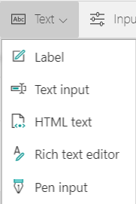
Commonly used controls
Interact with app by clicking or tapping
Show data such as text, numbers, date, or currency
Type text, numbers, or other data
Convert HTML tags automatically
Draw an image or text and save it to app or data source

Slide 11
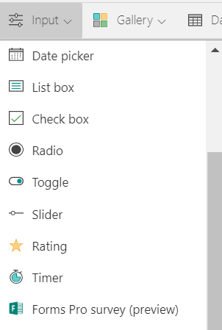
Mobile-friendly controls
Select or clear an option to specify true or false
Show options that are mutually exclusive
Drag a handle to specify true or false
Specify a value by dragging a handle
Indicate a value between 1 and a specified number

Slide 12
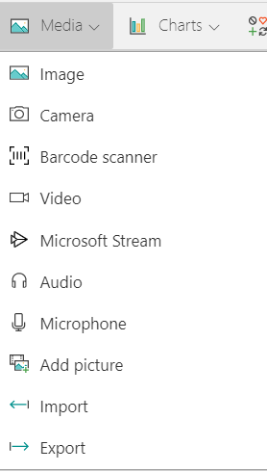
Media controls
Show an image from, for example, a local file or a data source.
Take and save photos in the app or to a data source.
Scan a barcode by using a device that has a camera.
Play a video clip from a local file, a data source, or YouTube.
Play an audio clip or the audio portion of a video clip.
Record and save sounds in the app or to a data source.
Load images from the local device for upload to a data source.

Slide 13
Create device gallery and setup filters Lab 3 – Exercise 1-3
Objectives
After completing this lab, you will be able to:
Add device gallery and connect to data source.
Arrange the device gallery.
Add gallery to show manufacturers.
Scenario
The organization wishes to build apps using the Power Apps platform to take advantage of No Code/Low Code application development in the cloud. As part of this effort, you are required to add controls and create formulas to add functionality to your app.
Notes:
See lab file M8_PowerApps_PowerUser_BuildingwithControlsFieldsandFormulas.docx and complete Exercises 1 - 3

Slide 14
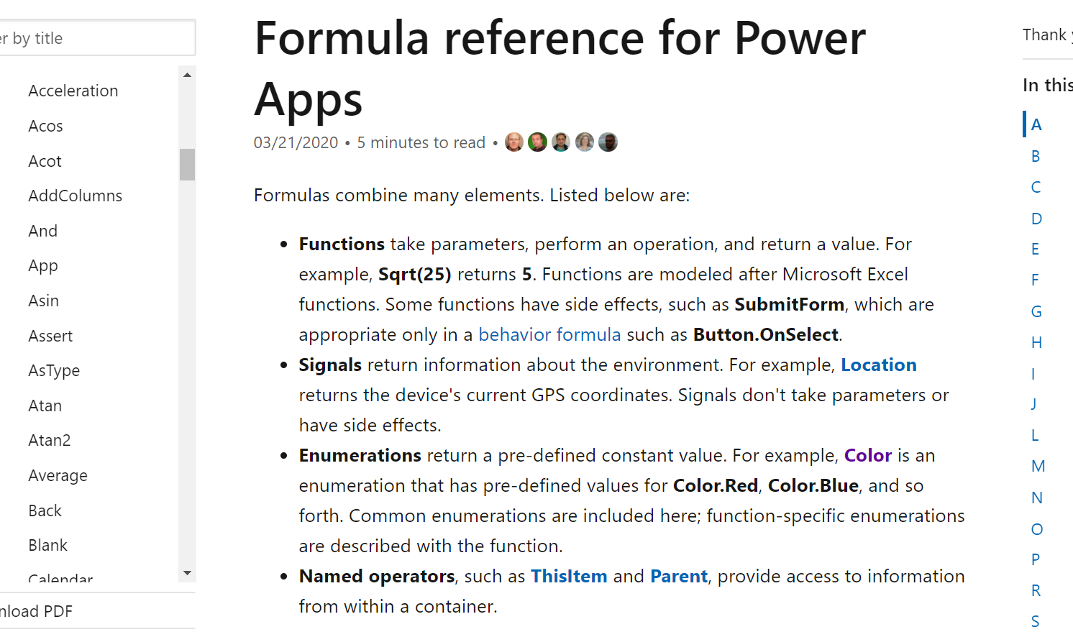
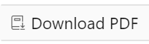
Formula types
Math
DateTime
String manipulation
Working with data records
Can download full PDF reference
Notes:
Power Apps contains many built-in formulas across the following categories:
Math functions such as Average, Median, etc.
Data time functions such as Now
String manipulation functions such as ToUpper, ToLower, SubString, etc.
Formulas for working with data records (Find, Filter, etc.)
Update link below: https://docs.microsoft.com/en-us/powerapps/maker/canvas-apps/formula-reference
https://powerapps.microsoft.com/en-us/tutorials/formula-reference/

Slide 15
Elements of formulas
Functions
Signals
Enumerations
Named Operators
Notes:
Discuss:
Functions
Take parameters, perform an operation, and return a value.
Modeled after Microsoft Excel functions. For example, Sqrt(25) returns 5.
Signals
Return information about the environment. i.e. Location returns the device's current GPS coordinates.
Don’t handle parameters or have side effects.
Enumerations
Return a pre-defined constant value i.e. Color is an enumeration that has pre-defined values for Color.Red, Color.Blue, and so forth.
Named Operators
- Named operators such as ThisItem and Parent, provide access to information.

Slide 16
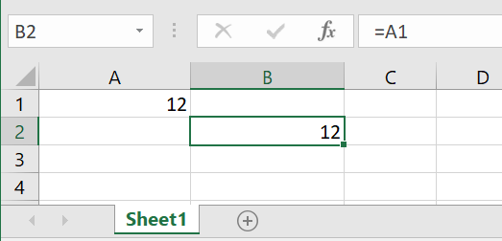
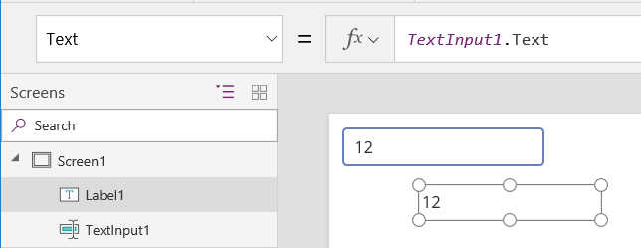
Formula references
Excel
Power Apps
Notes:
Discuss:
How in Excel
B1’s cell value depends on A1’s cell value
Automatically recalculated as A1 changes
How in Power Apps
Label1’s Text property depends on TextInput1’s Text property
Automatically recalculated as TextInput1 changes

Slide 17
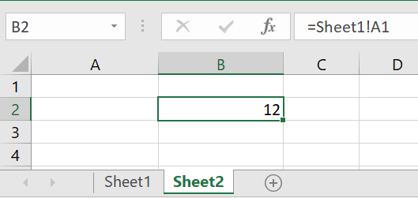
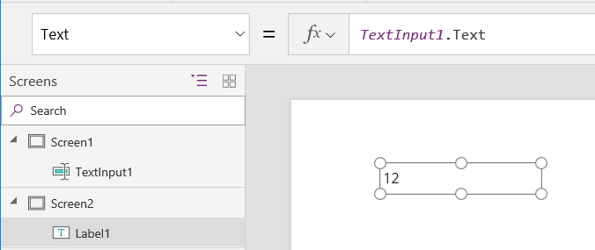
References across sheets/screens
Excel
Power Apps
Notes:
Discuss:
How in Excel
Formulas can reference any cell in the workbook
The entire workbook is recalculating all the time, even if we can’t see a sheet or hidden column
How in PowerApps
Formulas can reference any control property in the app
The entire app is recalculating all the time, even if we can’t see a screen or a control is invisible

Slide 18
Create manufacturer gallery and setup filters Lab 3 – Exercises 4-11
Objectives
Connect ManufacturerGallery to manufacturer's table.
Highlight the selected item in the gallery.
Filter the devices based on the selected manufacturer.
Configure text labels in the device gallery.
Apply conditional formation to highlight devices above $1,000.
Add a checkbox to add a device to the Compare list.
Create a collection for the selected devices.
Set the default selection to the first manufacturer and test the app.
Scenario
The organization wishes to build apps using the Power Apps platform to take advantage of No Code/Low Code application development in the cloud. As part of this effort, you are required to add controls and create formulas to add functionality to your app.
Notes:
See lab file M8_PowerApps_PowerUser_BuildingwithControlsFieldsandFormulas.docx and complete Exercises 4 - 11

Slide 19
Data types
Understanding controls
Understanding formulas
Power Apps and Excel formula comparisons

